Slide 1

Journey PPT
Customized Bootcamp – Week 4 Abhishek B M Batch 4

Slide 2
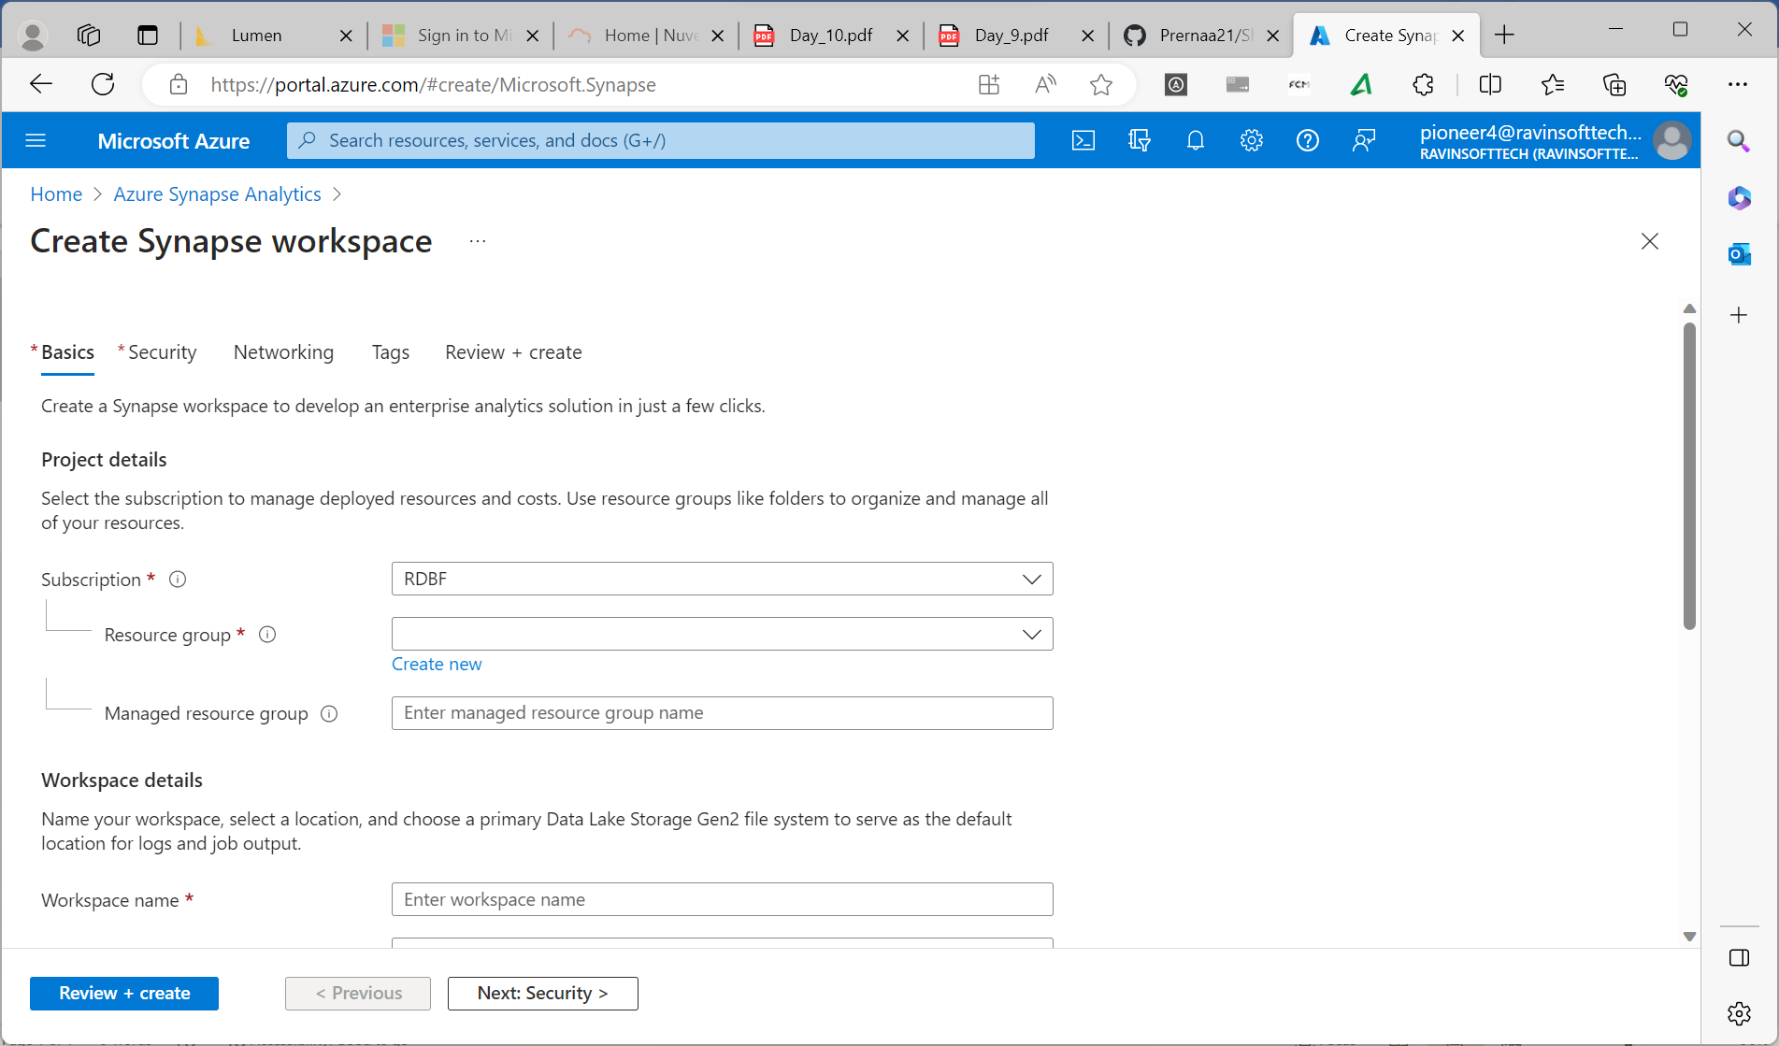
Azure Synapse Analytics Day 10
Created Azure Synapse Analytics Workspace
Dedicated and Serverless SQL pool.
Analyzed data in the storage account.
Integrated pipelines.
Querying and analyzing data.
Writing and executing queries.

Slide 3
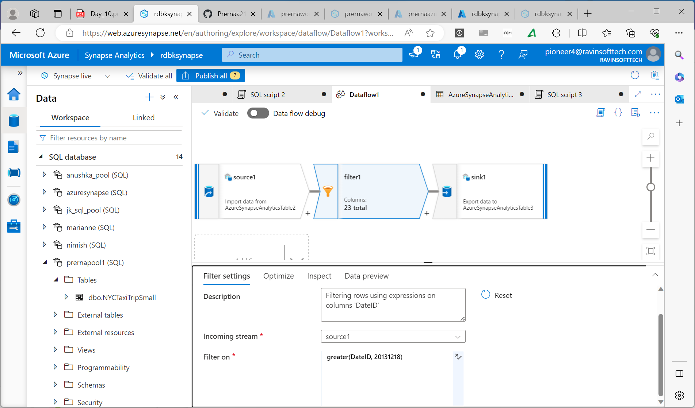
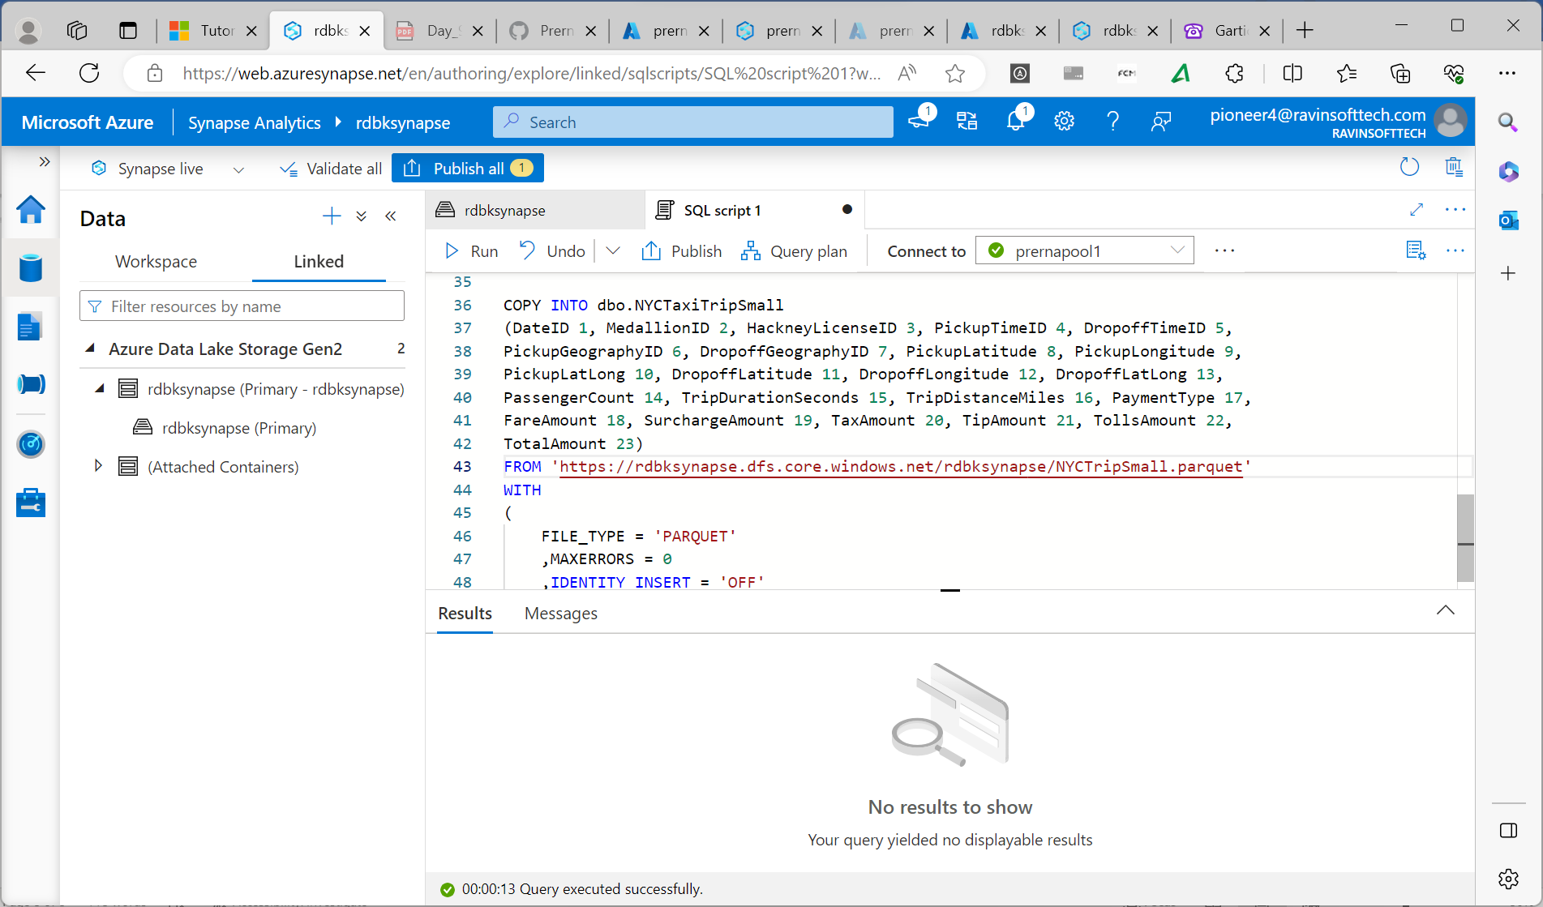

Slide 4
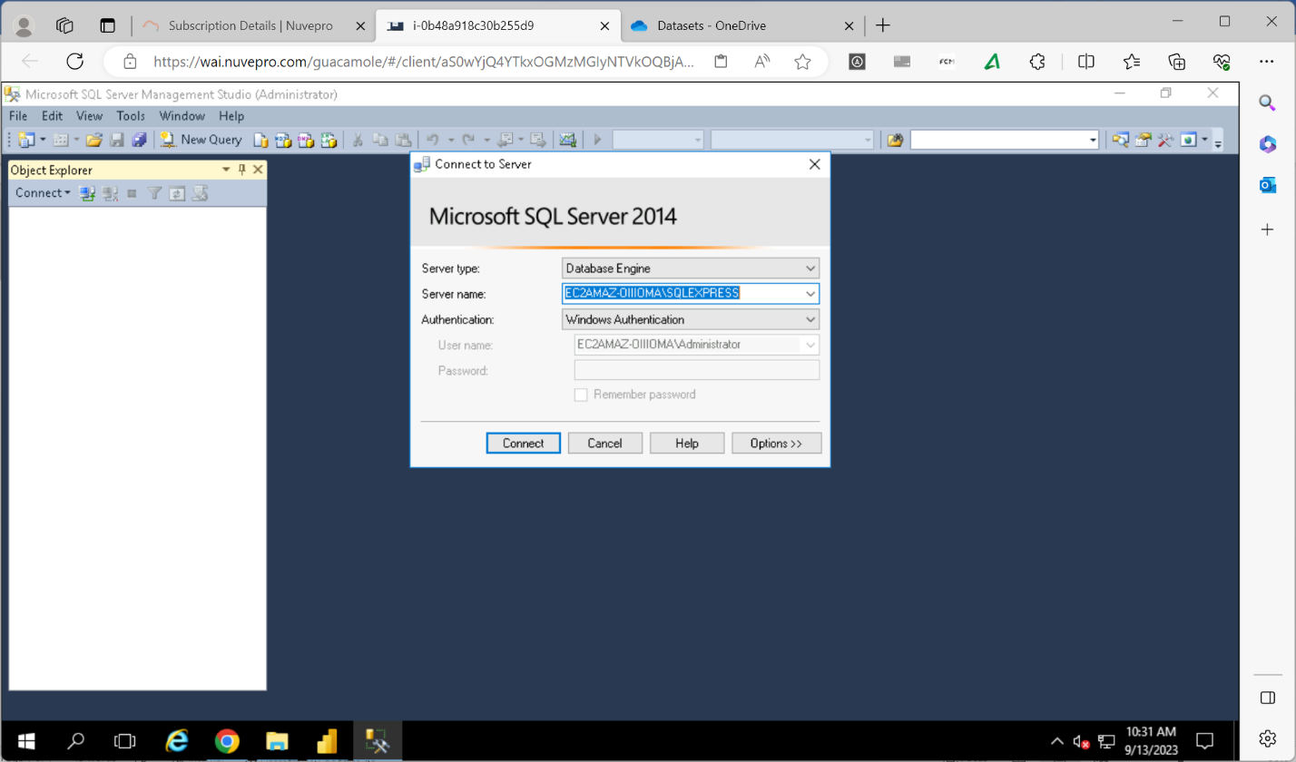
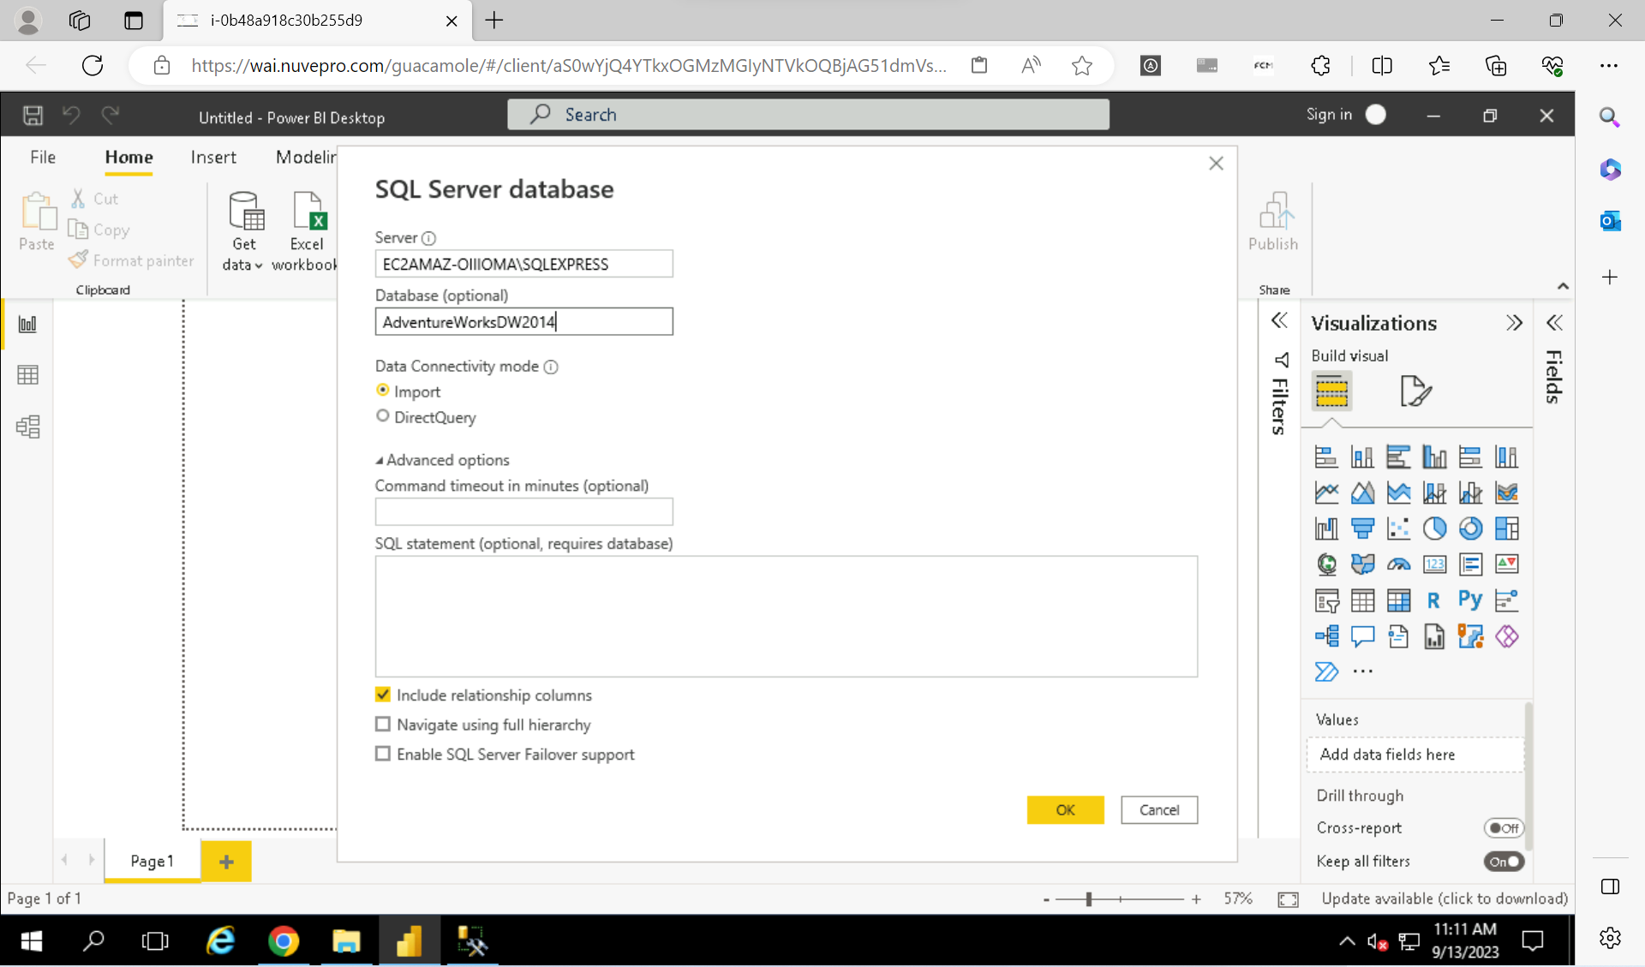
Power BI Day 1
Introduction to PowerBI.
External Plugins-
Power query- Data transformation and data preparation tool included with MS excel and power bi.
Power view, Power Pivot, Power Map
Power BI editor uses m language.
Dax function- data analysis expression, data visualization language.

Slide 5
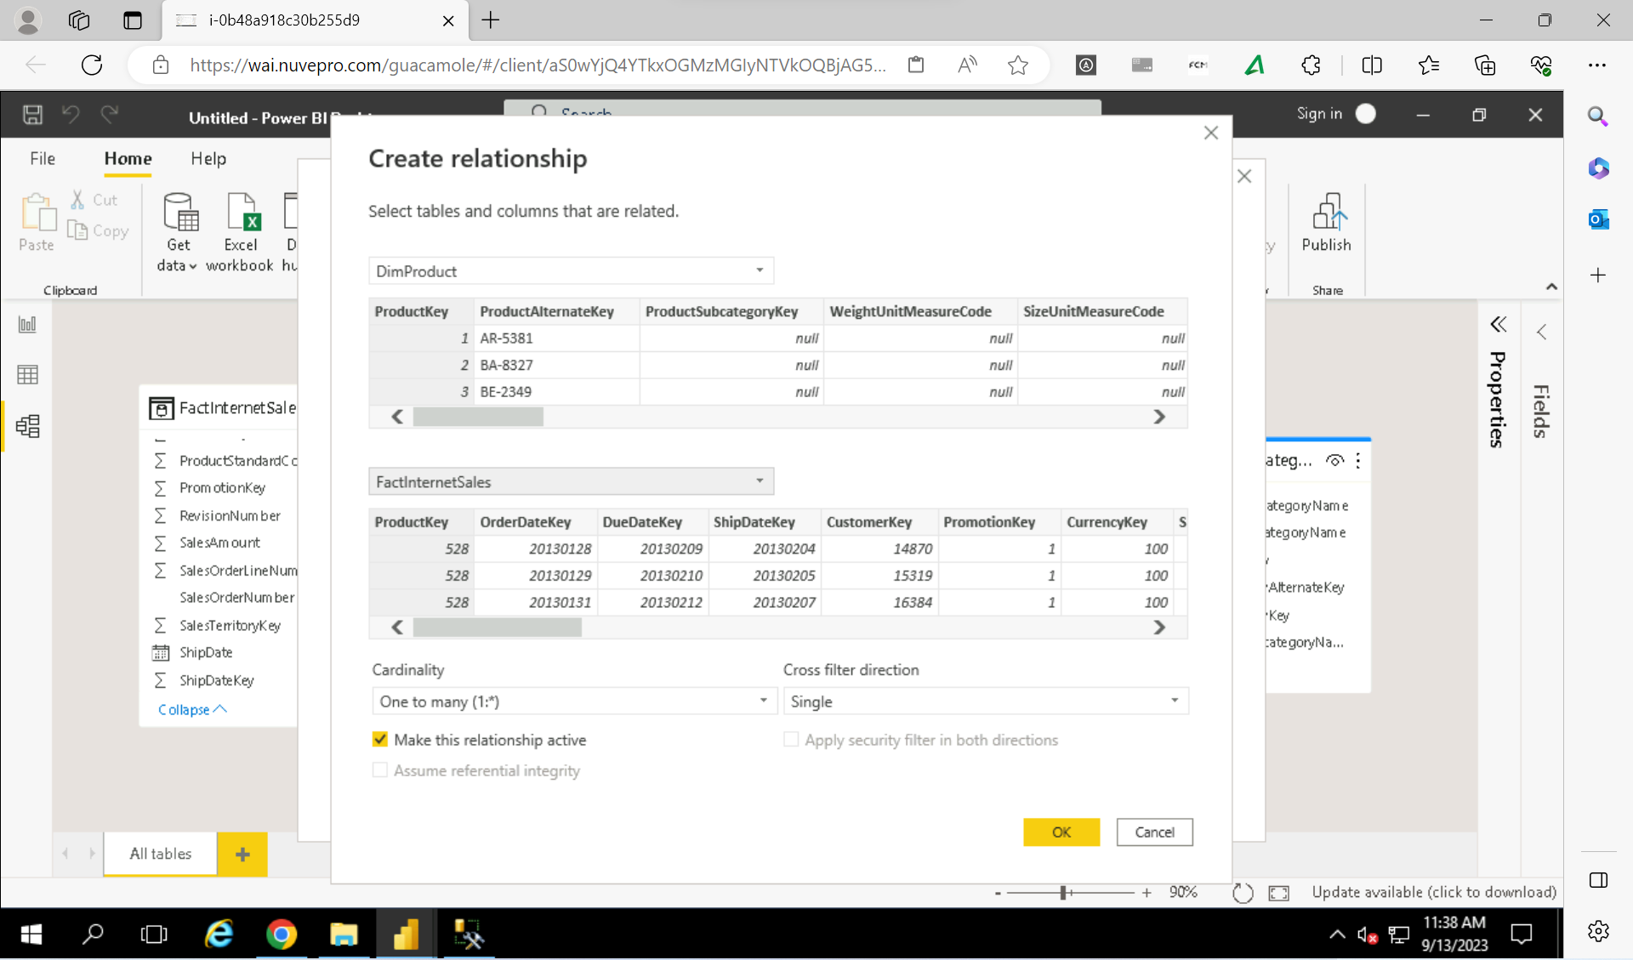
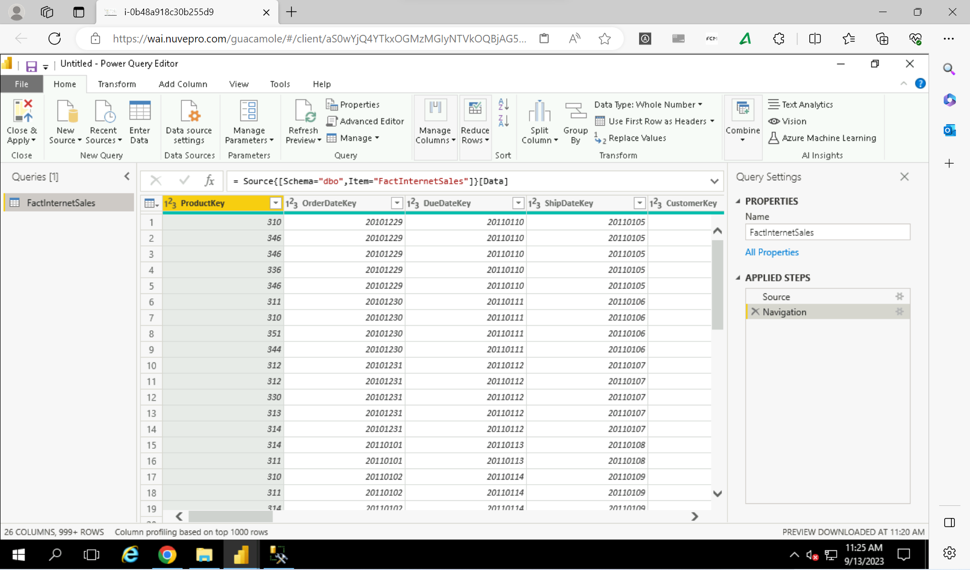
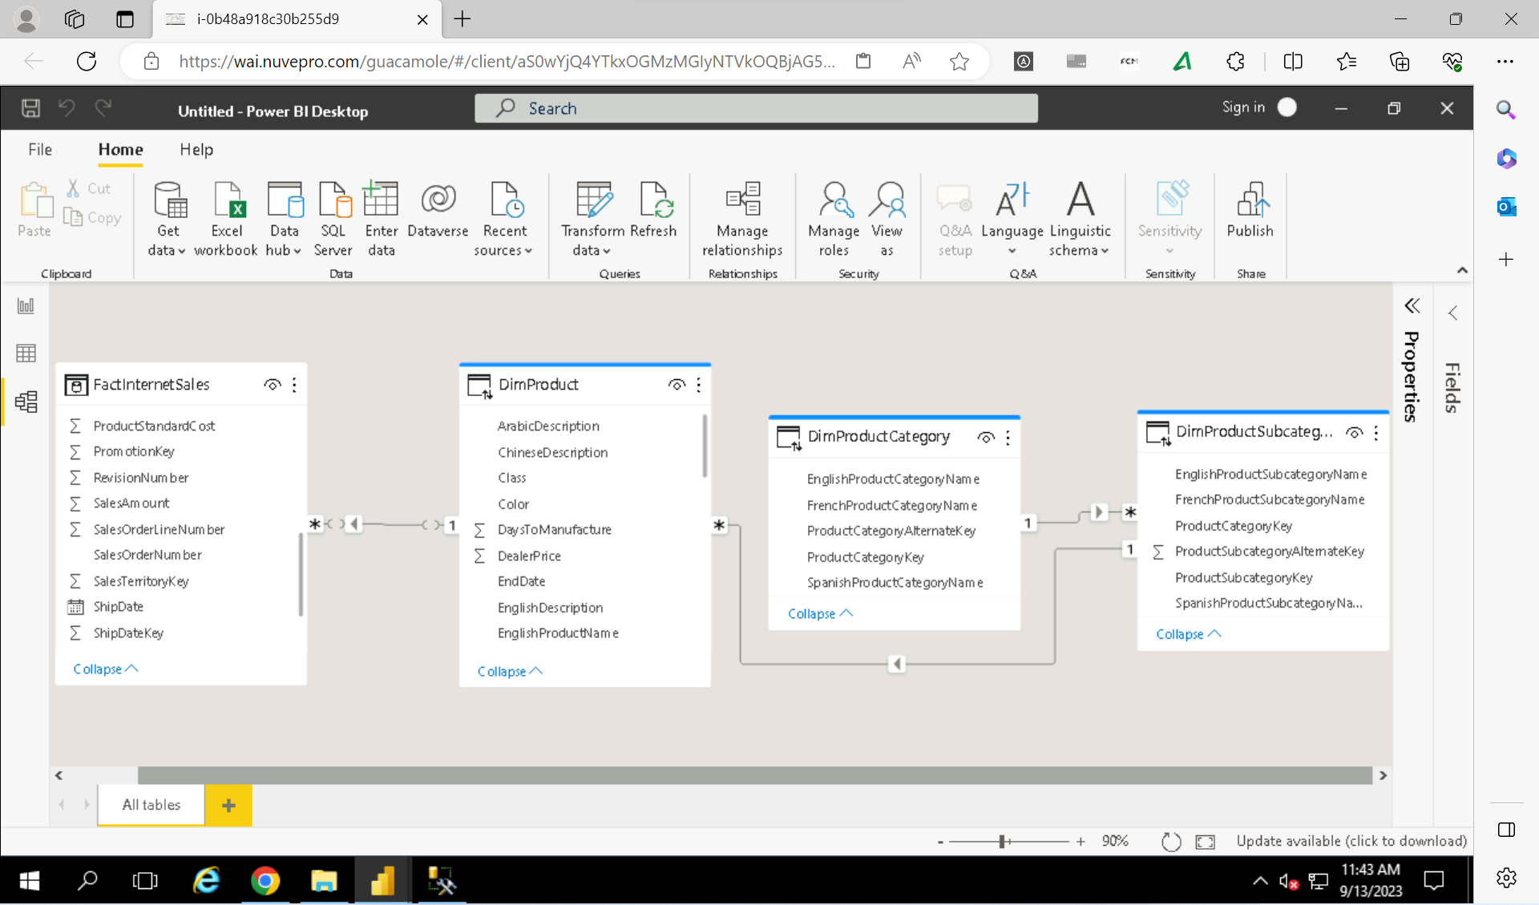
Connected to SQL Server.
Created Hierarchies and relationships.
Header Row promotions.
Merging, Splitting and Replacing.

Slide 6
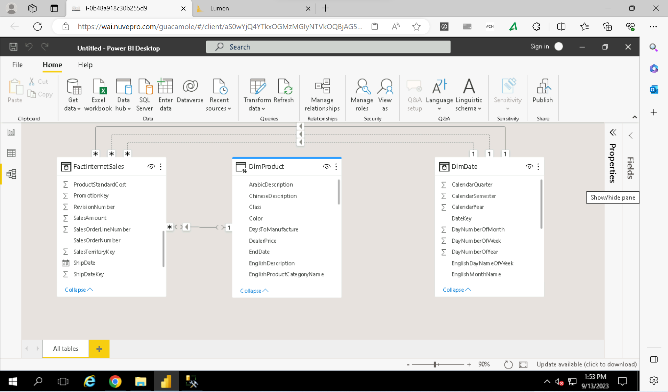
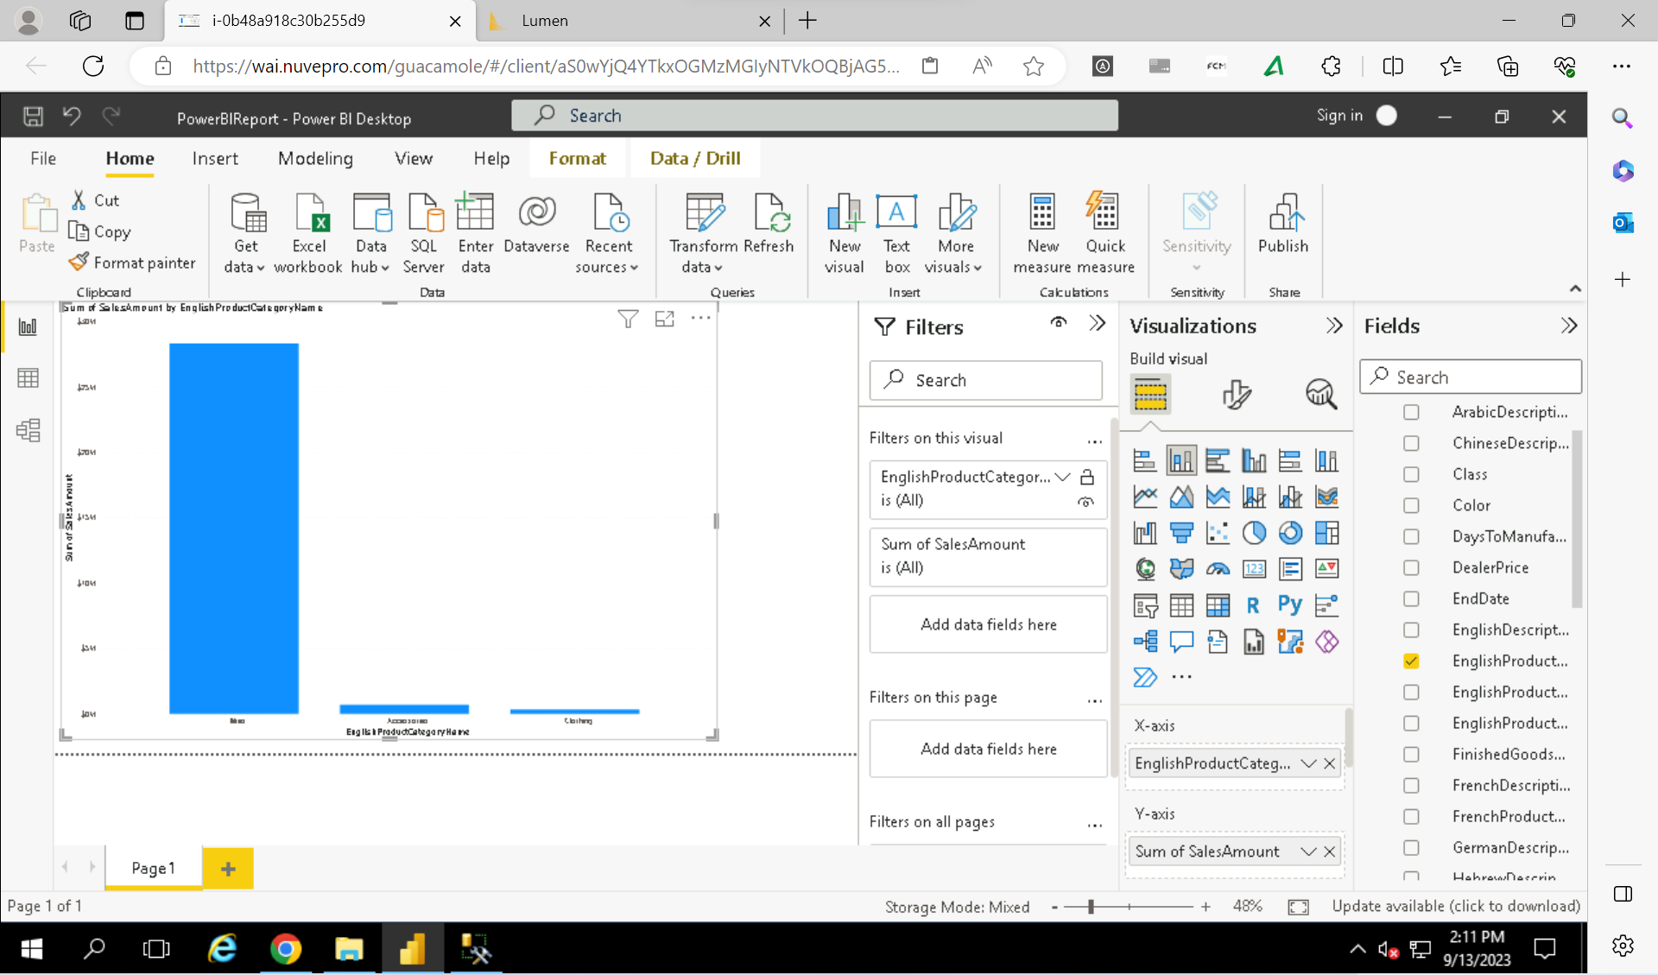
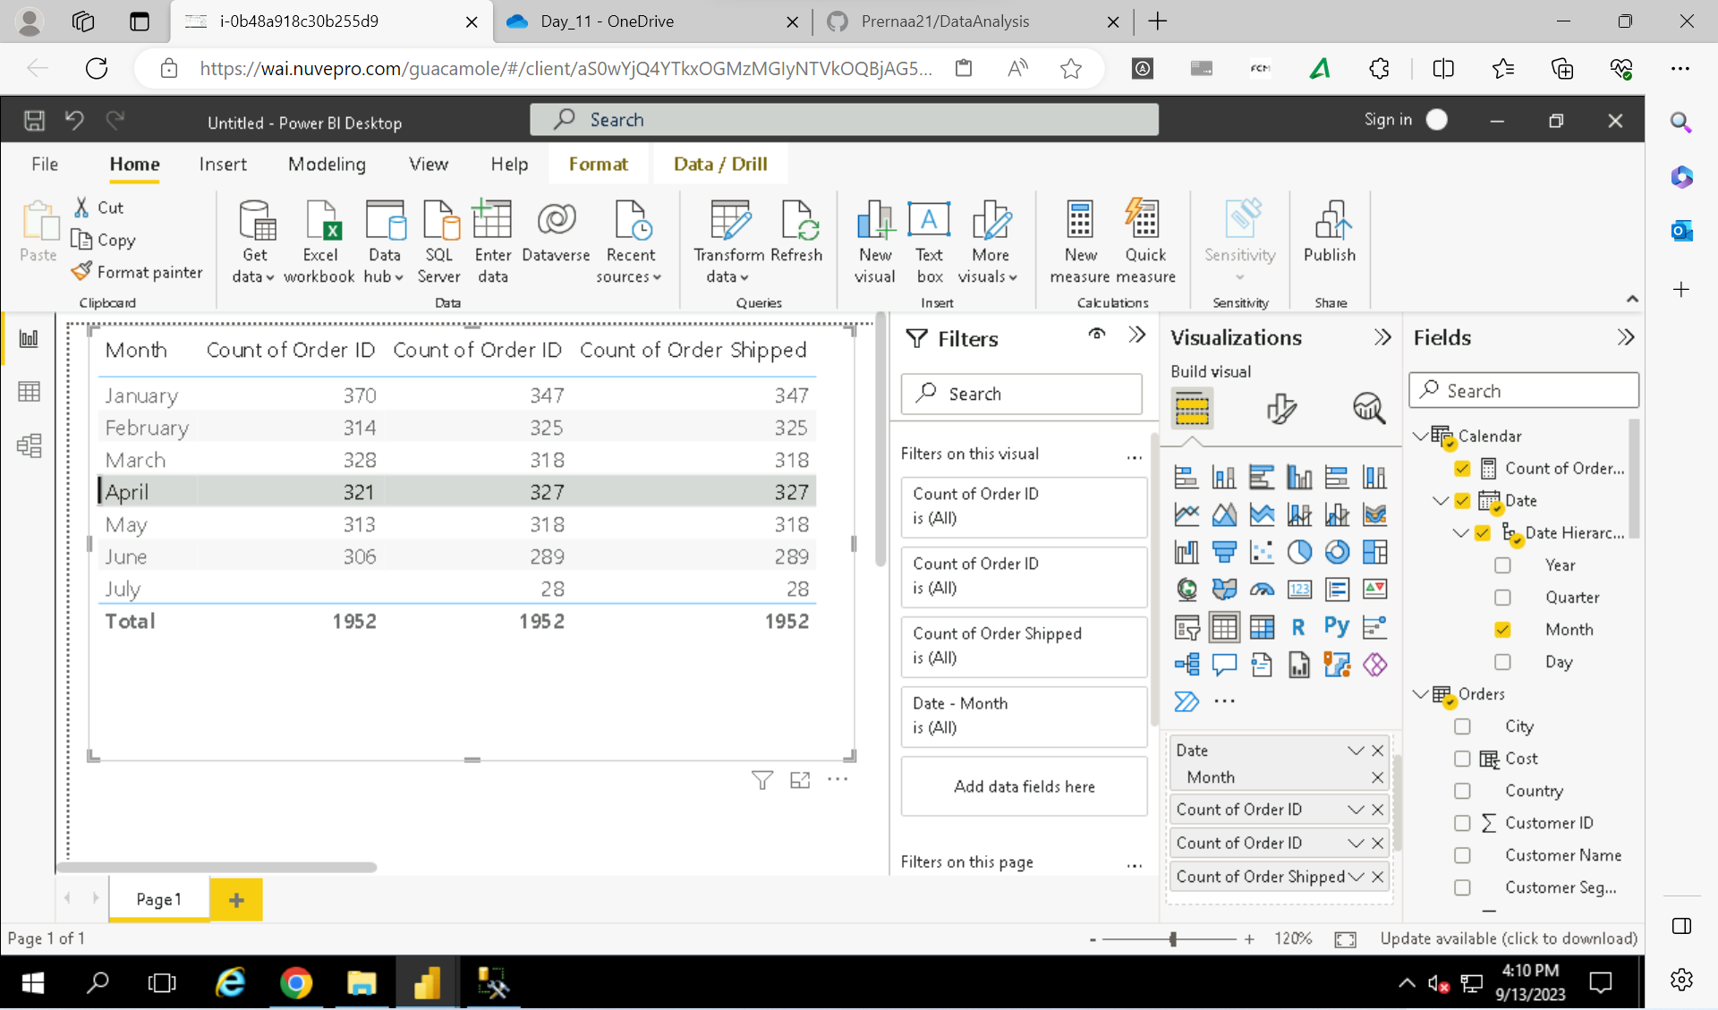

Slide 7
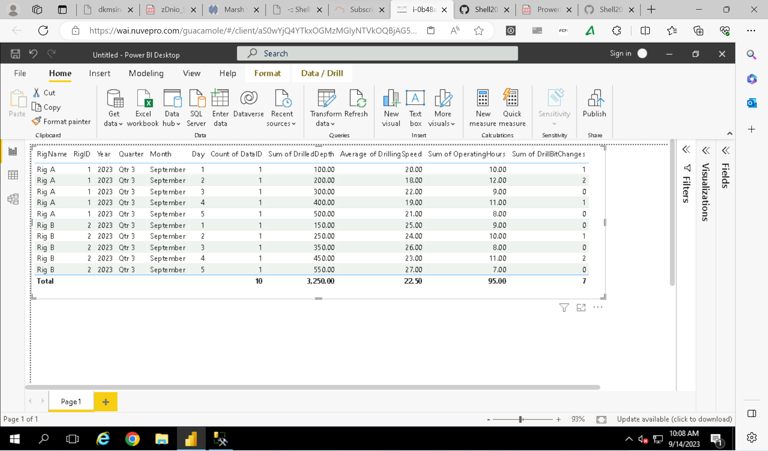
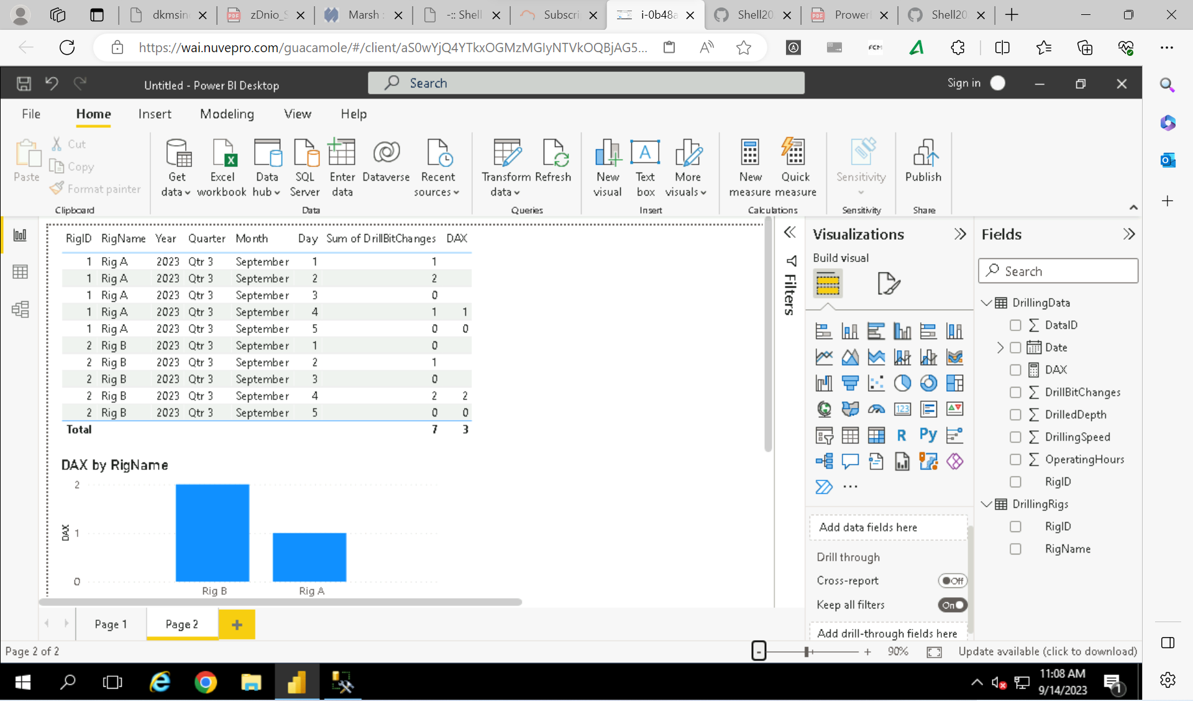
PowerBI Day 2
Data visualization- Created cards, slicers and various charts such as- donut chart, line chart, stacked column chart, area chart, bar chart, pie chart, scatter chart etc.
Drill up and drill down.
Hands on exercise on Energy consumption dataset- Loading, Transformation, Modelling, Power queries and Analysis.

Slide 8
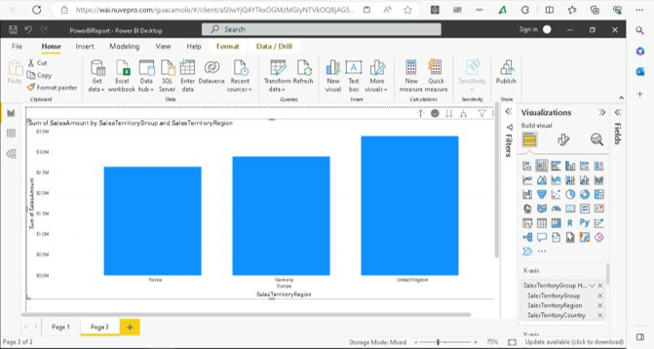
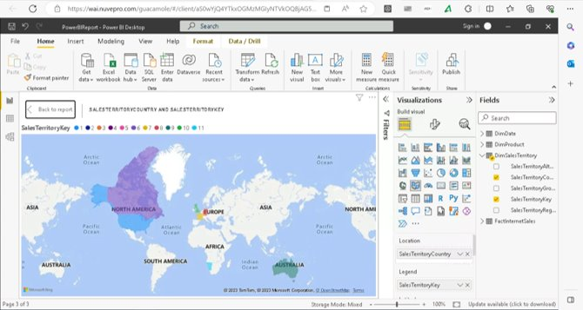
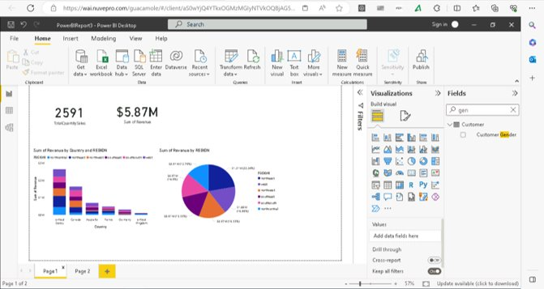
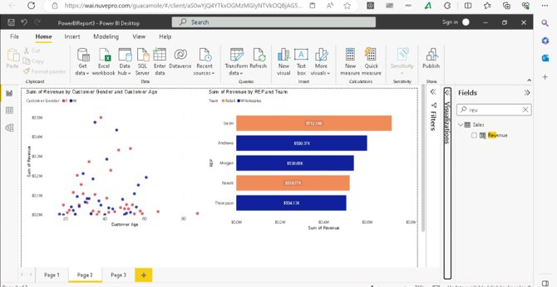

Slide 9
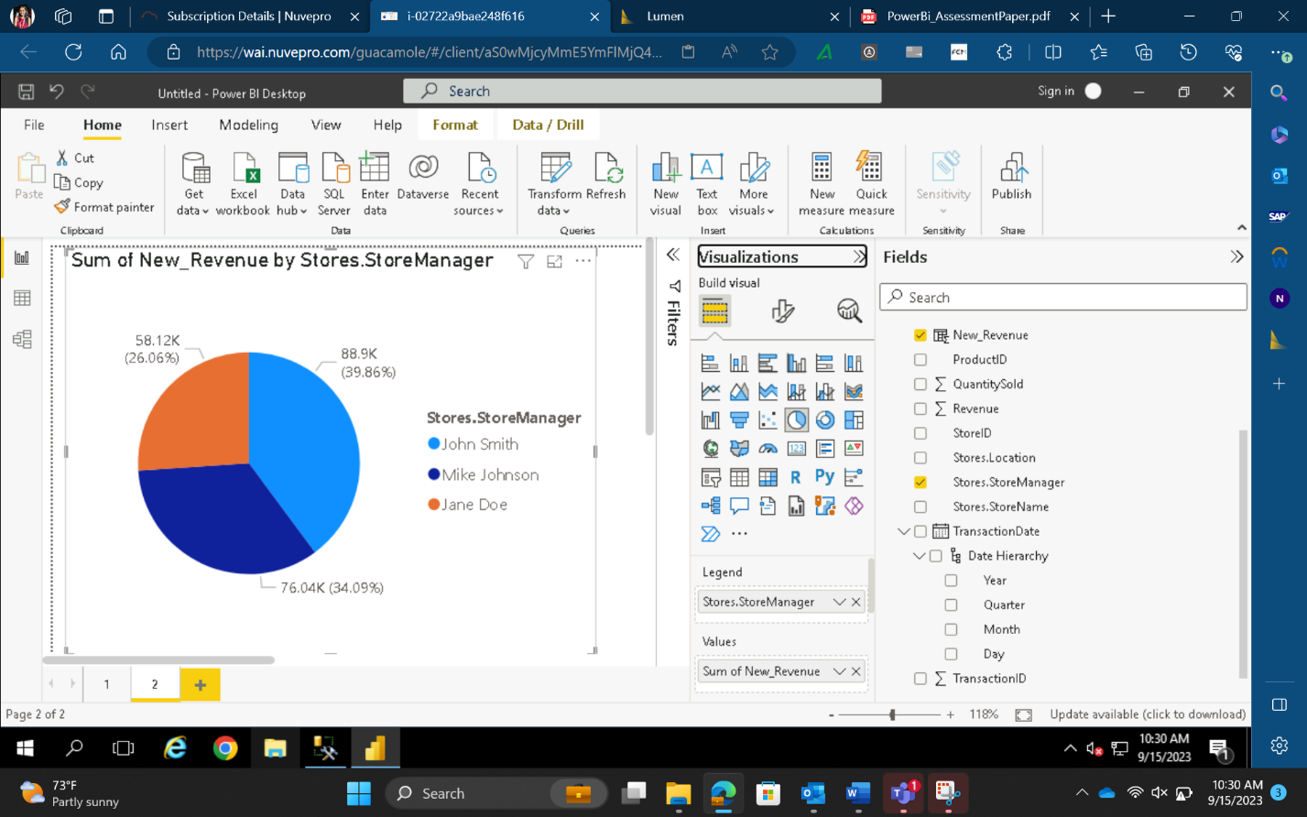
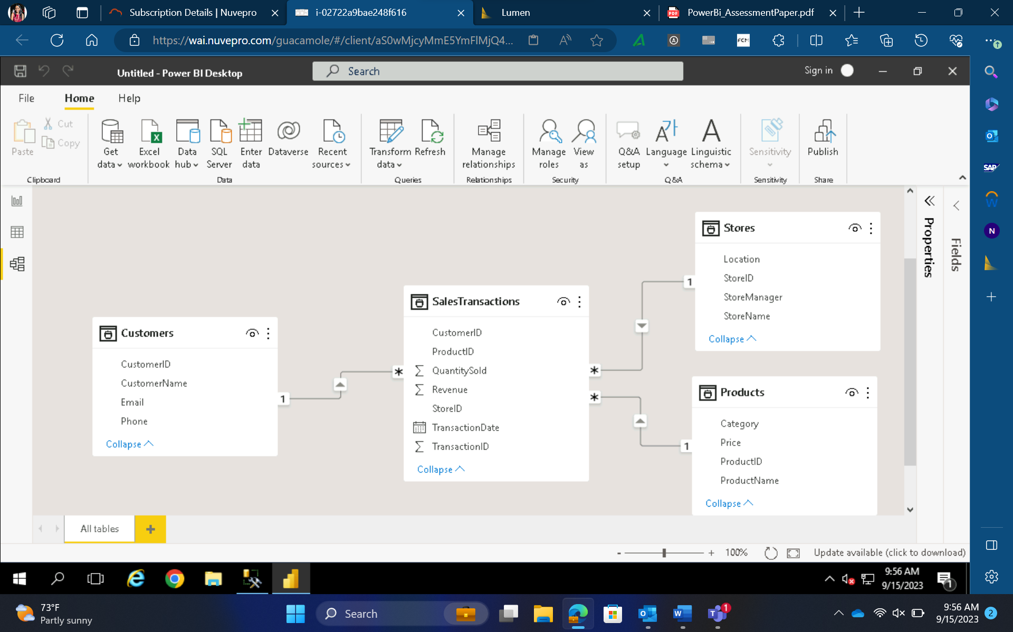
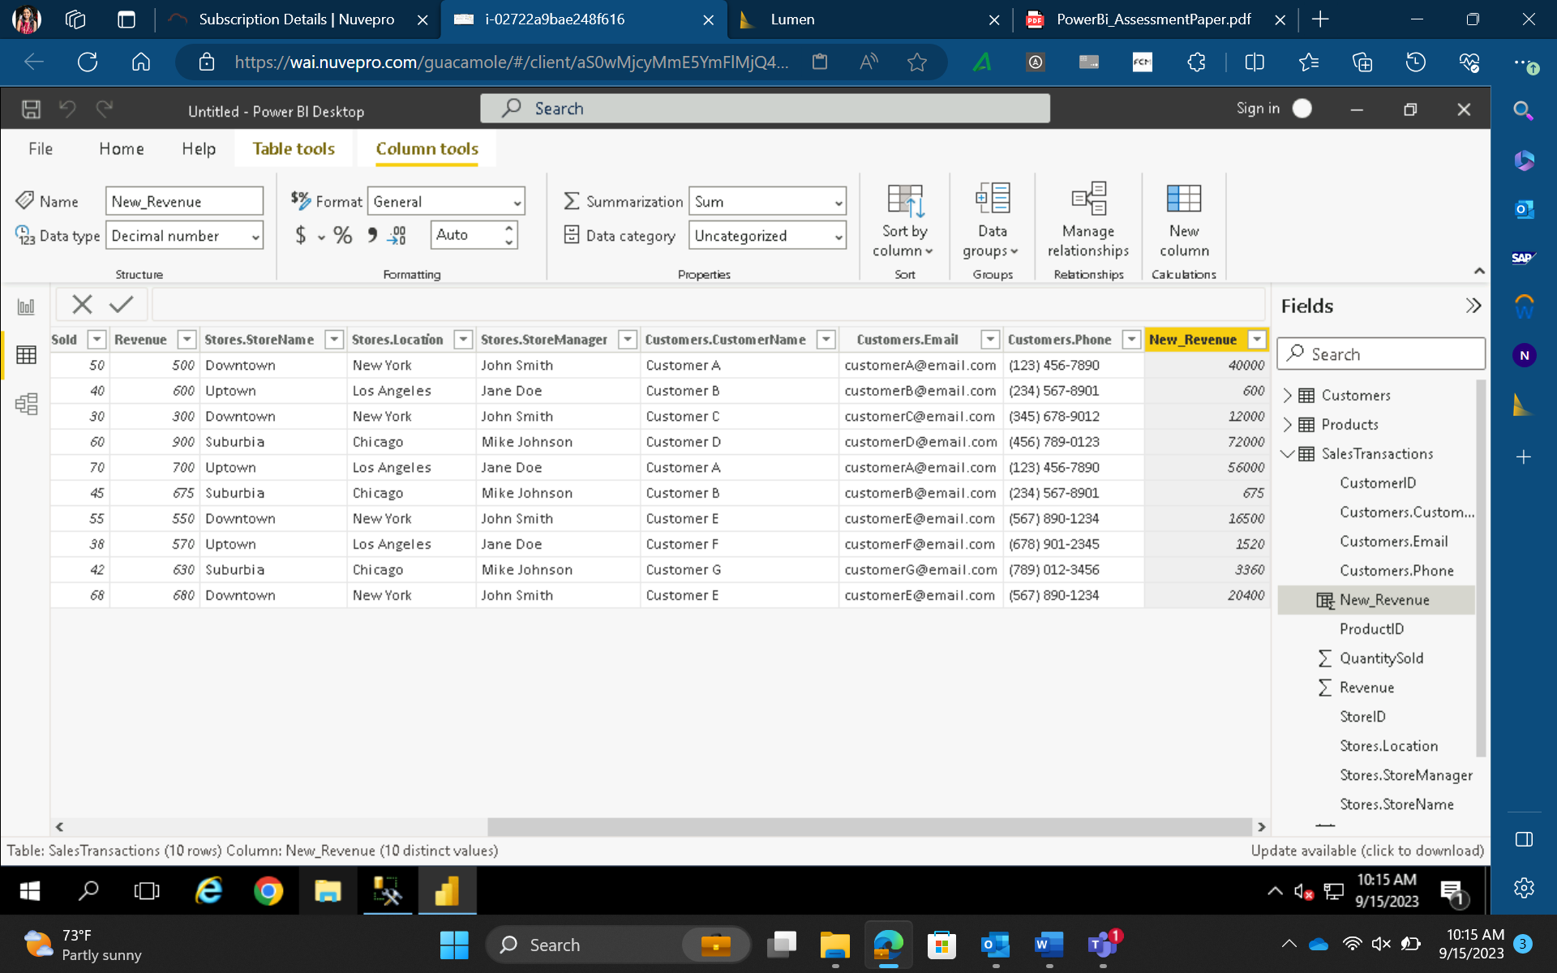
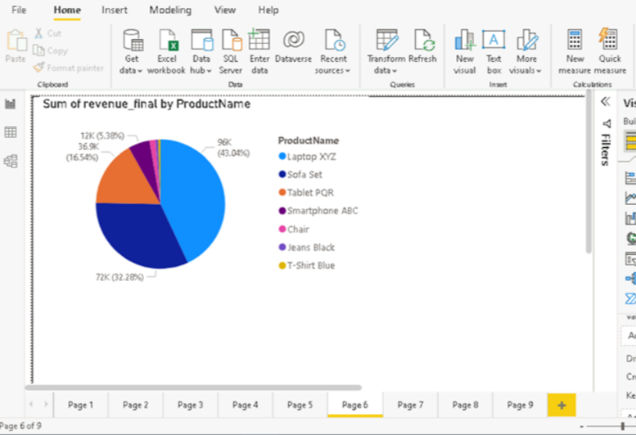
Case Study - PowerBI

Slide 10
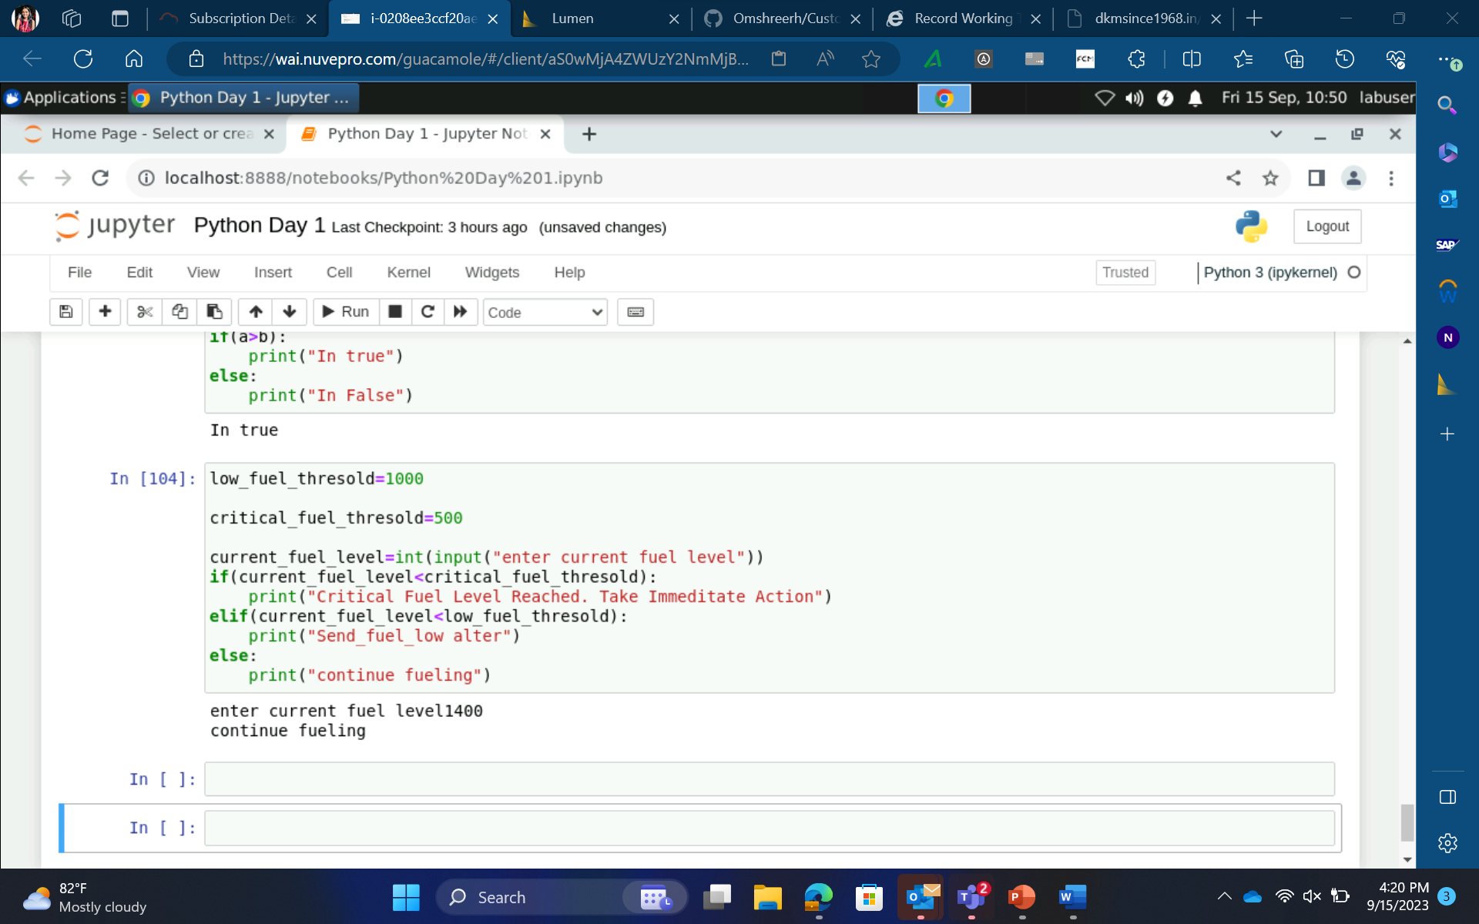
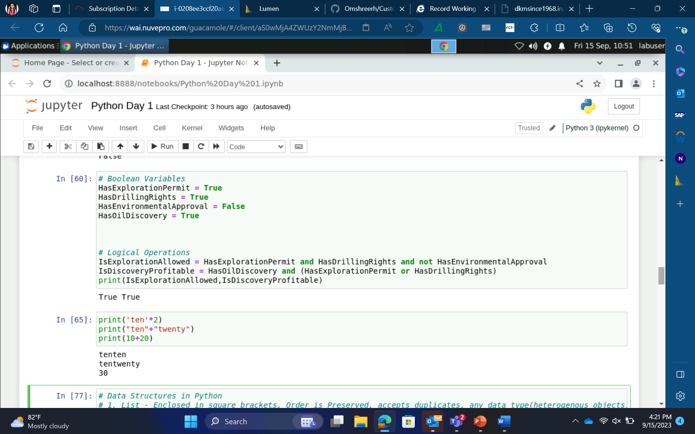
Python Day 1
•Learnt basics of python
•Python data types – Int, float, str, bool, list, dict, tuple etc.
•Mutable and Immutable objects
•Conditional statements – if, elif, else
•For loops

